Slide 1
Aspect Based Opinion Mining on Restaurant Reviews
Sazid Hasan Tonmoy (23241037)
Faiyaj Bin Ahmed (23141084)
Madhurjya Sarkar (18101574)
Mehejabin Binta Bashar (18101568)
Rafi Ahmed (16101065)
Supervised by
Dr. Farig Yousuf Sadeque
Co-Supervised by
Moin Mostakim

Slide 2
Table of Contents
Introduction
Problem Statement
Research Objectives
Previous Work
Research Methodology
Data Collection
Data Augmentation
Feature Extraction & Modeling
Topic Modeling
Classifier Models
Results & Analysis
Challenges, Limitation, & Future Work
Conclusion
Background of research
Problem Statement
Research Objectives
The journey of our research
Previous work
Research Methodology
Data Collection Considerations
Overview of Data
Feature Extraction Techniques
Classifier Models
Experimental Design
Results & Analysis
Conclusion & Future Work

Slide 3
Introduction
Online Reviews shape dining choices
Challenges arise from review volume and quality
Opinion Mining evaluates sentiments and Aspects
ABOM identifies key dimensions
Helps consumers make informed dining decisions

Slide 4
Problem Statement
Handling global restaurant reviews with vast natural language data is challenging
Extracting, categorizing, and detecting opinions and implicit aspects are intricate tasks
Cross-domain adaptation and using overall ratings are vital for effective Opinion Mining

Slide 5
Research Objectives
Compare ML and Deep Learning for ABOM
Evaluate Performance in Opinion Mining
Provide insights into practical applicability

Slide 6
Previous work
Classifier Models:
Naive Bayes models
Support Vector Algorithms
Hierarchical-based Bidirectional LSTM
Sentiment Utility Logistic Model (SULM)
Deep Convolutional Neural Network (CNN) architecture
UDA framework for sentiment analysis
Feature Extraction Techniques:
Vector representations of text data
Vector space approach
Word embedding features for each word in phrases
DomBERT for domain-oriented language modeling
Unified Domain Adaptation (UDA) framework for cross-domain extraction of aspects

Slide 7
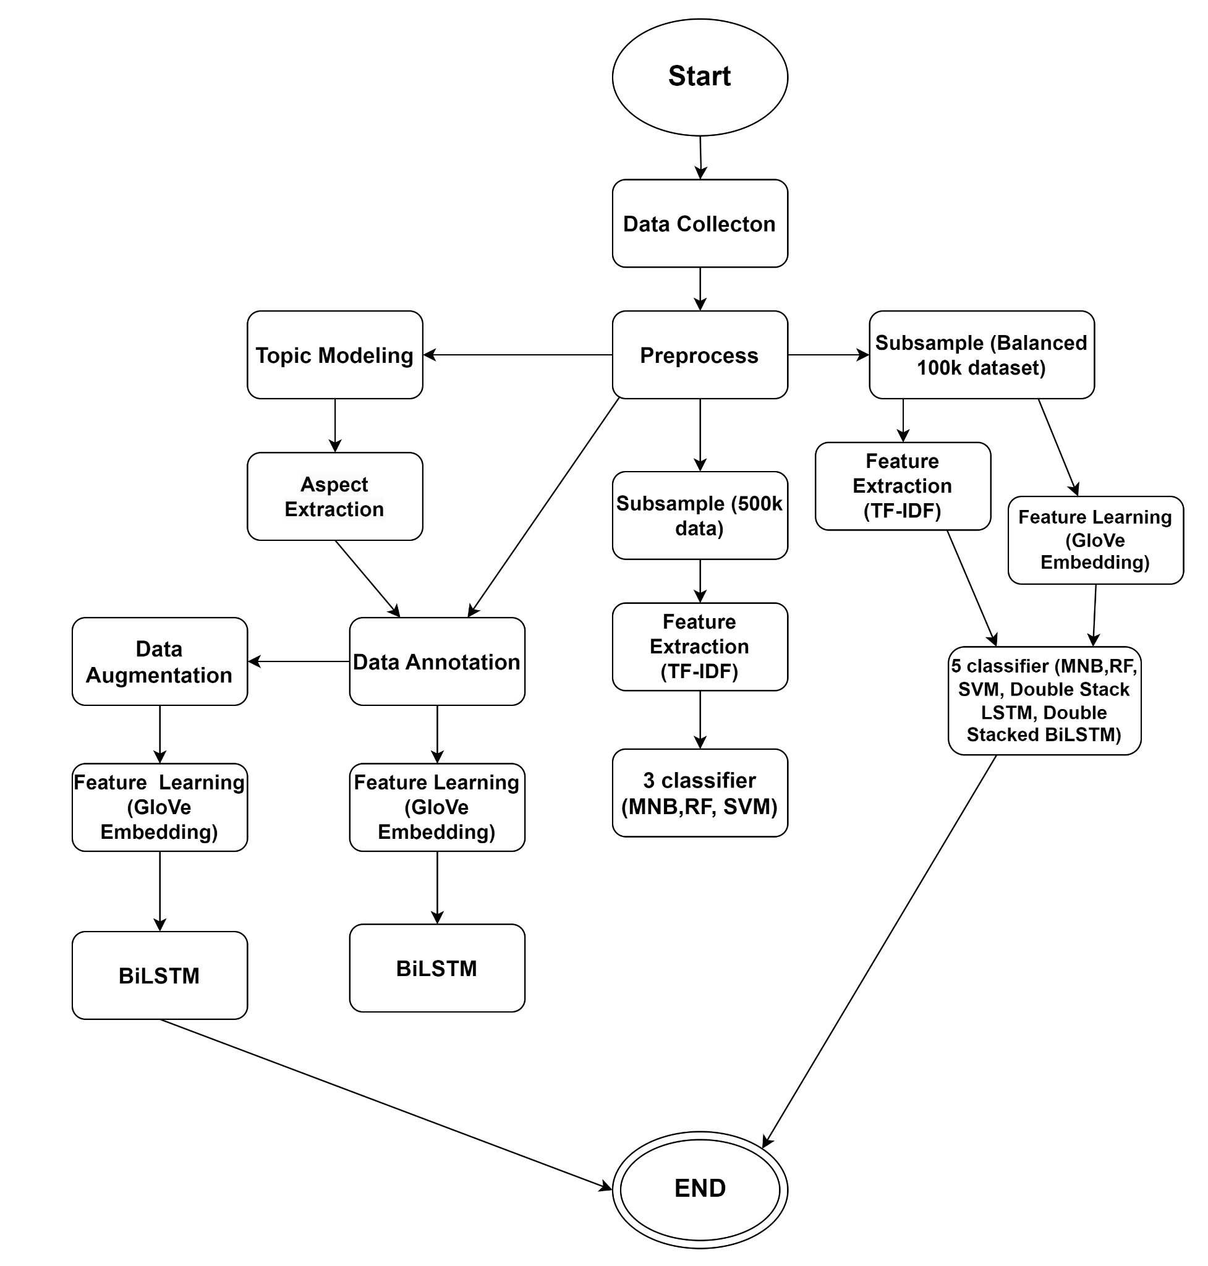
Research Methodology
Developed ABOM Model
2.7 million Restaurant reviews from Kaggle
Preprocessing
Aspect Identification: Employing LDA for Topic Modeling
Subjectivity and Objectivity Classification: MNB, Random Forest, SVM and LSTM Networks
Model Evaluation: Assessed performance using various metrics

Slide 8
Data Collection
:
Obtained the "Six TripAdvisor Datasets for NLP Tasks" dataset from Kaggle, featuring 2.7 million restaurant reviews across six global cities: Barcelona, London, Madrid, New Delhi, New York, and Paris.
Selected based on the paper "Explain and Conquer: Personalized Text-based Reviews to Achieve Transparency."

Slide 9
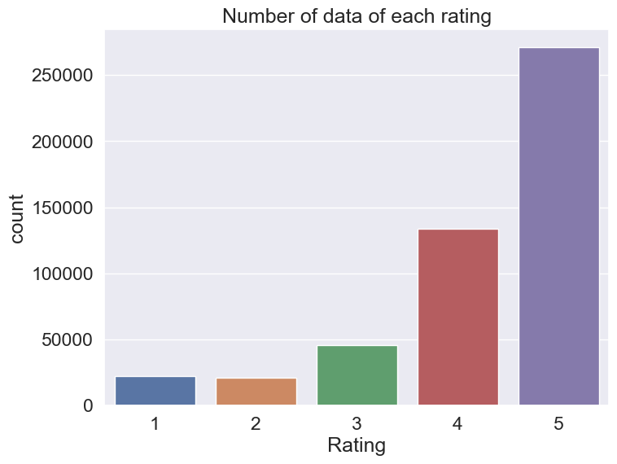
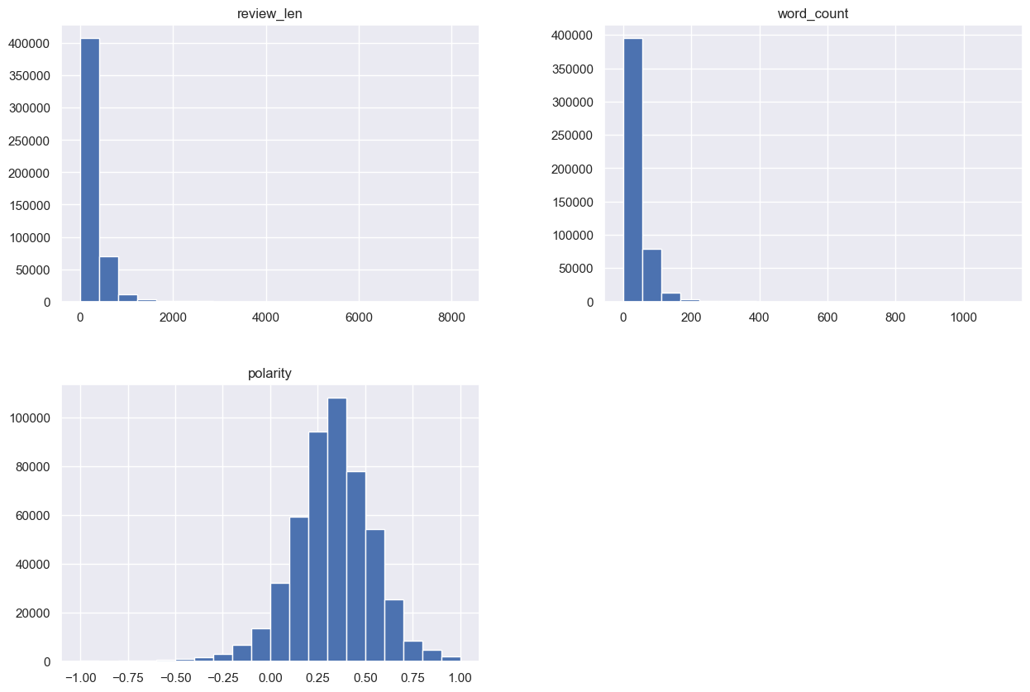
Data Collection
Figure: Number of Data Each Rating
Figure: Histogram of review_len, word_count and polarity

Slide 10
Data Augmentation
NLPaug Library
Aspect-Based Augmentation
Augmentation Techniques
Synonym Augmentation (Positive Sentiment)
Antonym Augmentation (Negative Sentiment)
Neutral Sentiment Preservation
Review Length Standardization
Augmentation Hyper-parameters

Slide 11
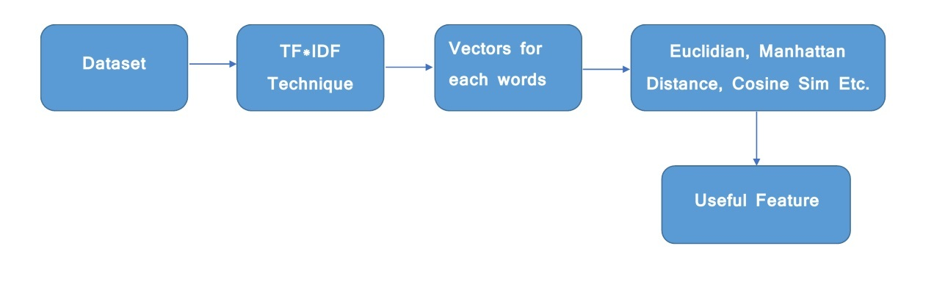
Feature Extraction Techniques: TF-IDF
Used widely in NLP and Text Analysis
Used for information retrieval to represent how important/relevant a specific word to its document or corpus by normalizing the words which occur frequently in the collection of documents.
Assigns weights to words based on their frequency in a document (TF) and rarity across the entire dataset (IDF)
Implemented using sklearn class Tfidfvectorizer

Slide 12
Feature Learning: GloVe Embeddings
Unsupervised learning algorithm for obtaining vector representations for words
Has pre-defined dense vectors for around every 6 billion words of English literature along with characters
4 varieties available (50d, 100d, 200d and 300d) and Words are key and dense vectors are values of key
Preprocess the text data > Create the dictionary > Traverse the glove file of a specific dimension and compare each word with all words in the dictionary >if a match occurs, copy the equivalent vector from the glove and paste into embedding_matrix at the corresponding index

Slide 13
Topic Modeling: LDA
Topic Modeling and Its Significance:
Unsupervised technique for discovering topics within text data
Crucial for organizing vast textual information and categorizing documents
Valuable in scenarios like reviews to extract key topics or themes
LDA (Latent Dirichlet Allocation):
Widely used for topic modeling in text corpora
Discovers hidden topics in documents
Models documents as mixtures of topics, and topics as mixtures of words
Controlled by hyperparameters alpha (α), beta (β), and the number of topics (k)
Identifies Aspects in restaurant reviews like Food, Place, Service, and Price
aspects are pivotal in shaping sentiment and are employed for sentiment classification
implemented LDA model using gensim package

Slide 14
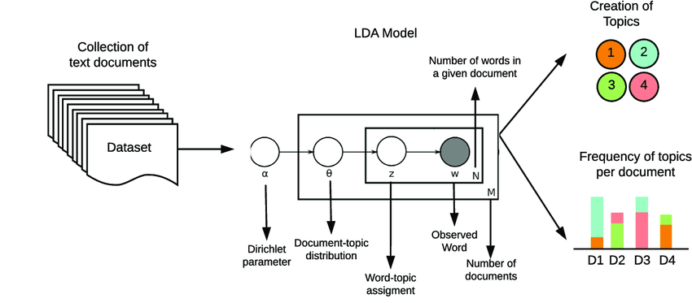
Topic Modeling: LDA

Slide 15
Classifier Models
Multinomial Naive Bayes
Random Forest
Support Vector Machine
Double Stacked LSTM
Double Stacked BiLSTM
BiLSTM
Background of research
Problem Statement
Research Objectives
The journey of our research
Previous work
Research Methodology
Data Collection Considerations
Overview of Data
Feature Extraction Techniques
Classifier Models
Experimental Design
Results & Analysis
Conclusion & Future Work

Slide 16
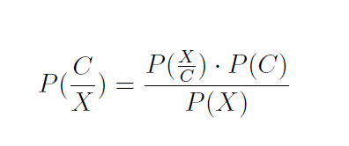
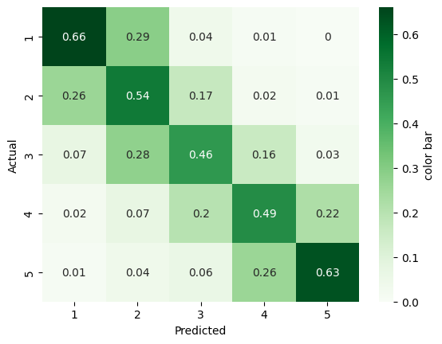
Classifier Models: MNB
Assumes multinomial distribution of features (words) within each class
Likelihood P(X/C) can be estimated using TF-IDF
Applies Bayes’ theorem to classify the sentiment polarity of the text documents
Applies Laplace smoothing to prevent zero probabilities. It improves the classifier’s robustness

Slide 17
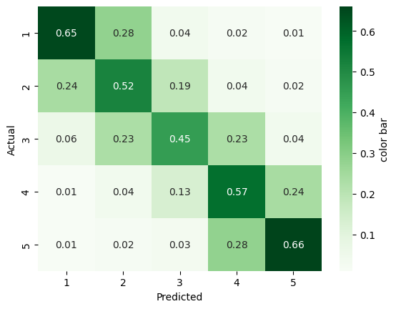
Classifier Models: Support Vector Machine (RBF Kernel)
Utilizes Radial Basis Function (RBF) kernel for non-linear decision boundaries
Training optimizes hyperplane to maximize margin and minimize error
Predicts sentiment polarity based on the
decision function's score.
Effective for sentiment classification with tunable kernel parameters like gamma
Uses TF-IDF for feature extraction

Slide 18
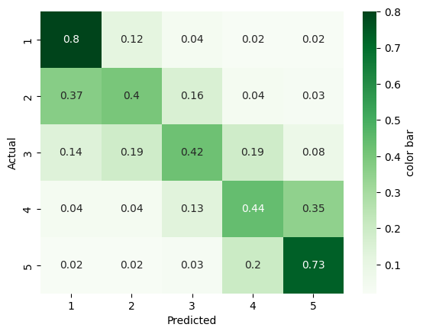
Classifier Models: Random Forest
Ensemble of Decision Trees
Tree trained on Random Subsets
Uses Bootstrap Aggregating (Bagging)
Feature Randomness during Tree-building
Predictions via majority vote of Trees
Robust for text Sentiment/Opinion
Mining
Fig: Random Forest (100K Data)

Slide 19
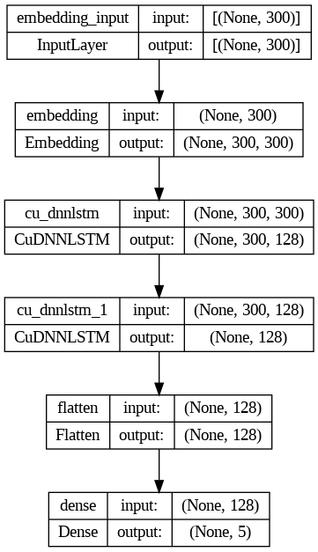
Classifier Models: Double-layered LSTM
Two stacked LSTM layers
Each layer takes the previous layer output
Captures complex patterns and long-range dependencies
Enhances Opinion Mining with context and depth

Slide 20
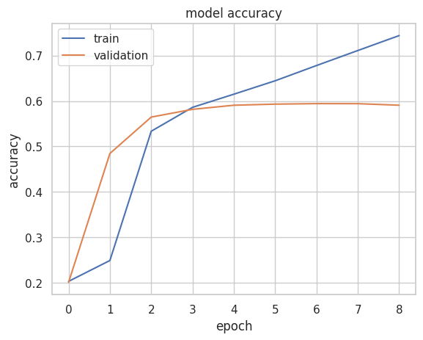
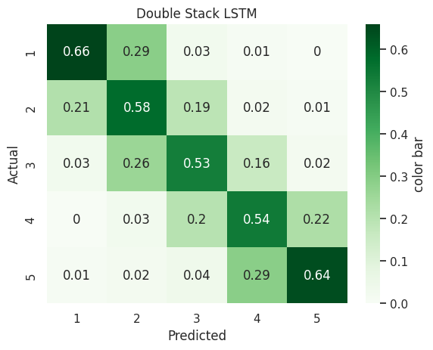
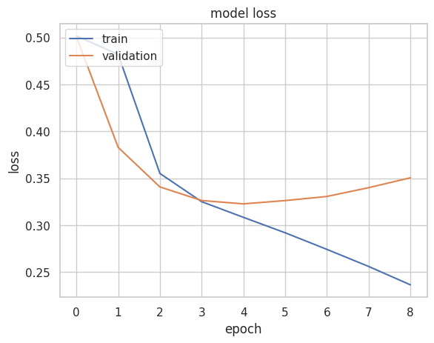
Classifier Models: Double-layered LSTM
Fig: Double-layered LSTM (100K Data)

Slide 21
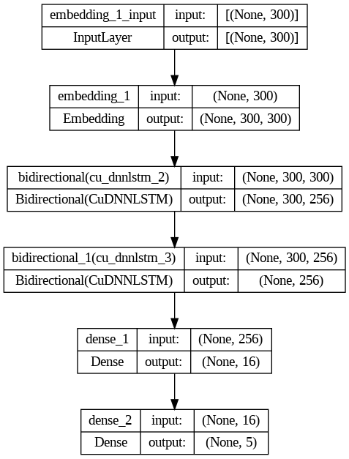
Classifier Models: Double Stack BiLSTM
Sequential Context Understanding
Bidirectional Information Flow
Long-Term Dependencies

Slide 22
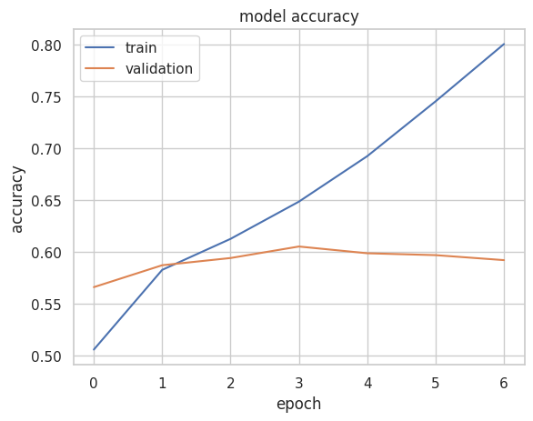
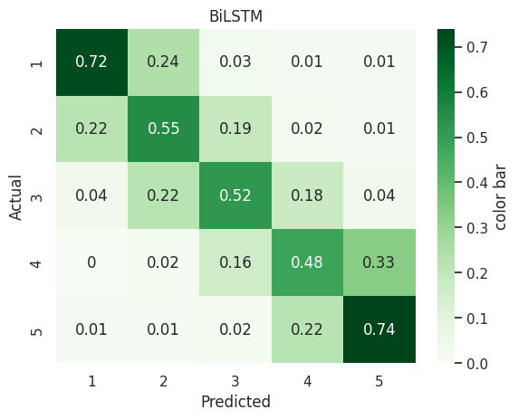
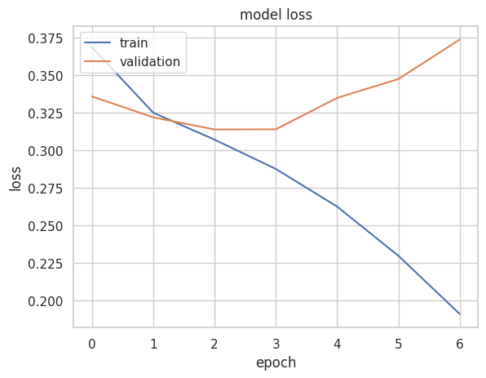
Classifier Models: Double Stack BiLSTM
Fig: Double Stack BiLSTM (100K Data)

Slide 23
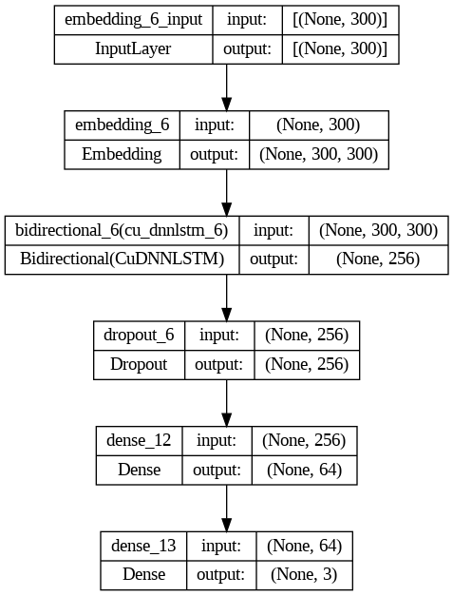
Classifier Models: Bidirectional LSTM

Slide 24
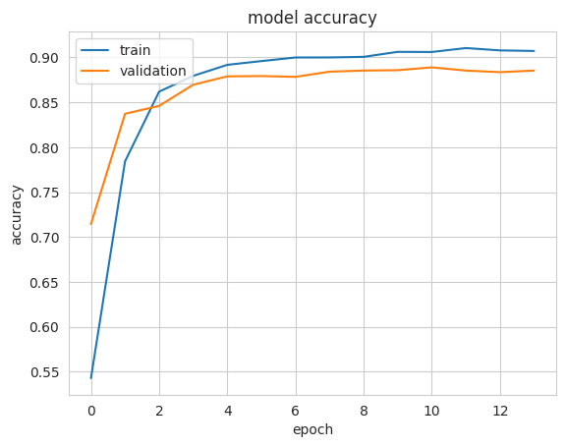
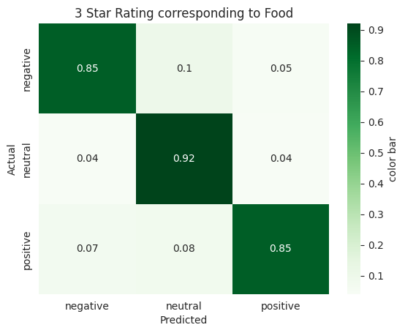
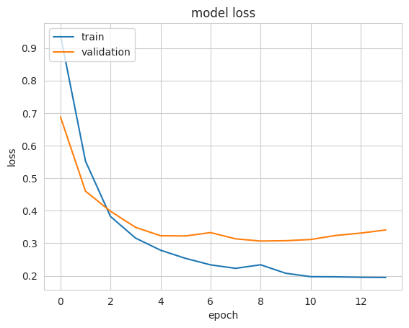
Classifier Models: BiLSTM for Food

Slide 25
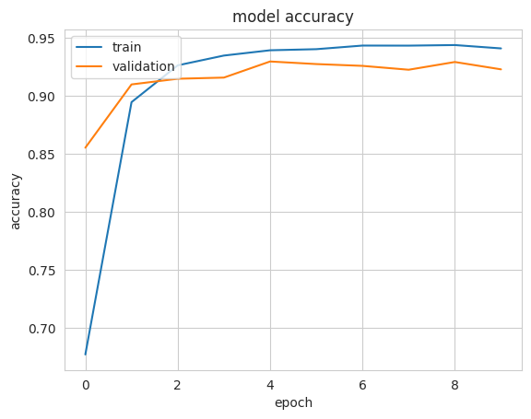
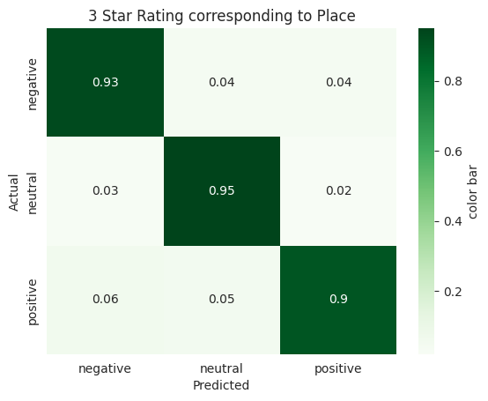
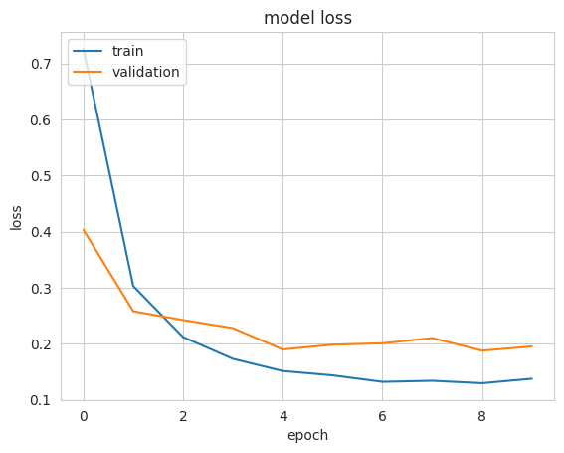
Classifier Models: BiLSTM for Place

Slide 26
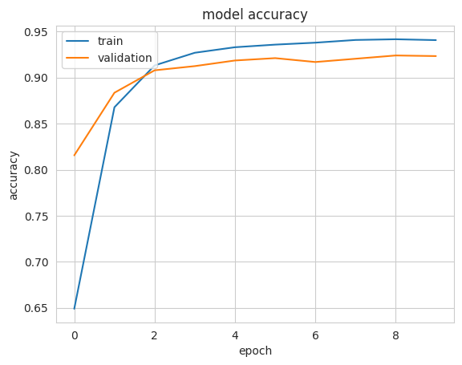

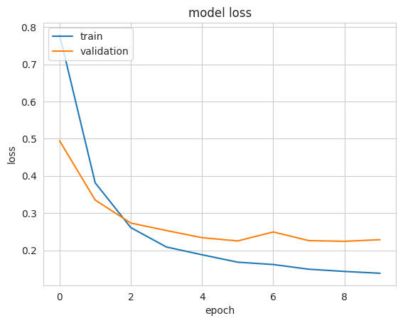
Classifier Models: BiLSTM for Service

Slide 27
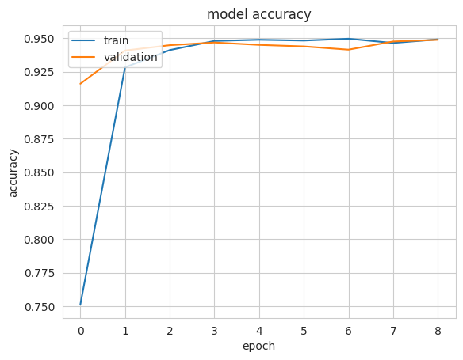
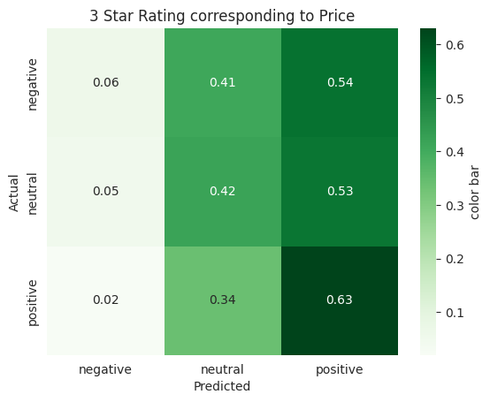
Classifier Models: BiLSTM for Price

Slide 28
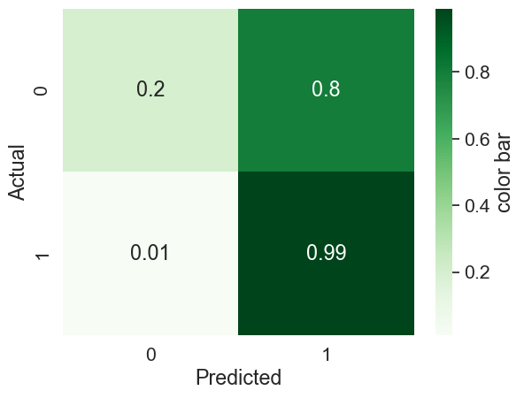
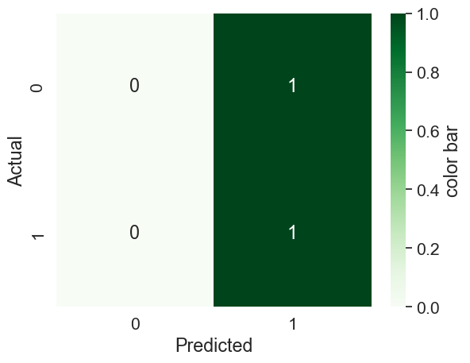
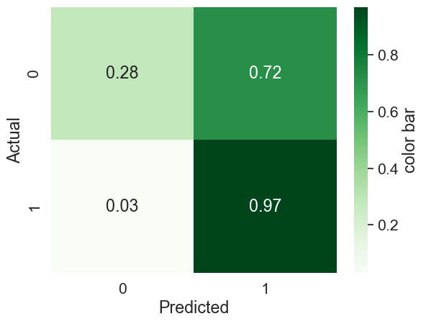
Results & Analysis: Multi-Model Study (500K Dataset)
Algorithm | Precision | Recall | F1 Score
SVM | 0.91155 | 0.911551 | 0.911551
MNB | 0.903327 | 0.903327 | 0.903327
Random Forest | 0.900671 | 0.900671 | 0.900671
Table 1: Result Comparison for 500k Data
Confusion Matrix for SVM
Confusion Matrix for Naive Bayes
Confusion Matrix for Random Forest

Slide 29
Results & Analysis: Multi-Model Study (100K Dataset)
Rating | Precision | Recall | F1-score
1 | 0.65 | 0.66 | 0.65
2 | 0.44 | 0.54 | 0.49
3 | 0.49 | 0.46 | 0.48
4 | 0.52 | 0.49 | 0.51
5 | 0.71 | 0.63 | 0.67
Macro avg | 0.56 | 0.56 | 0.56
Weighted avg | 0.56 | 0.56 | 0.56
Rating | Precision | Recall | F1-score
1 | 0.67 | 0.65 | 0.66
2 | 0.47 | 0.52 | 0.50
3 | 0.54 | 0.45 | 0.49
4 | 0.50 | 0.57 | 0.53
5 | 0.69 | 0.66 | 0.68
Macro avg | 0.58 | 0.57 | 0.57
Weighted avg | 0.58 | 0.57 | 0.57
Table 4: Result Comparison for Naive Bayes
Table 4: Result Comparison for SVM

Slide 30
Results & Analysis: Multi-Model Study (100K Dataset)
Rating | Precision | Recall | F1-score
1 | 0.58 | 0.80 | 0.68
2 | 0.53 | 0.39 | 0.45
3 | 0.53 | 0.42 | 0.47
4 | 0.51 | 0.45 | 0.48
5 | 0.61 | 0.73 | 0.66
Macro avg | 0.55 | 0.56 | 0.55
Weighted avg | 0.55 | 0.56 | 0.55
Table 4: Result Comparison for Random Forest

Slide 31
Results & Analysis: Multi-Model Study (100K Dataset)
Rating | Precision | Recall | F1-score
1 | 0.74 | 0.65 | 0.69
2 | 0.49 | 0.60 | 0.54
3 | 0.53 | 0.52 | 0.52
4 | 0.52 | 0.51 | 0.51
5 | 0.69 | 0.65 | 0.67
Macro avg | 0.59 | 0.59 | 0.59
Weighted avg | 0.59 | 0.59 | 0.59
Rating | Precision | Recall | F1-score
1 | 0.73 | 0.72 | 0.72
2 | 0.53 | 0.55 | 0.54
3 | 0.56 | 0.52 | 0.54
4 | 0.52 | 0.48 | 0.50
5 | 0.65 | 0.74 | 0.69
Macro avg | 0.60 | 0.60 | 0.60
Weighted avg | 0.60 | 0.60 | 0.60
Table 4: Result Comparison for Double Stacked LSTM
Table 4: Result Comparison for Double Stacked BiLSTM

Slide 32
Results & Analysis: Based on Aspects
Rating | Precision | Recall | F1-score
Negative | 0.8773 | 0.8543 | 0.8656
Neutral | 0.8406 | 0.9171 | 0.8772
Positive | 0.9072 | 0.8504 | 0.8779
Macro avg | 0.8750 | 0.8739 | 0.8736
Weighted avg | 0.8754 | 0.8737 | 0.8736
Rating | Precision | Recall | F1-score
Negative | 0.91 | 0.93 | 0.92
Neutral | 0.92 | 0.95 | 0.93
Positive | 0.94 | 0.90 | 0.92
Macro avg | 0.92 | 0.92 | 0.92
Weighted avg | 0.92 | 0.92 | 0.92
Table 4: Result Comparison for Food
Table 5: Result Comparison for Place

Slide 33
Results & Analysis: Based on Aspects
Rating | Precision | Recall | F1-score
Negative | 0.93 | 0.90 | 0.92
Neutral | 0.90 | 0.97 | 0.93
Positive | 0.94 | 0.89 | 0.91
Macro avg | 0.92 | 0.92 | 0.92
Weighted avg | 0.92 | 0.92 | 0.92
Rating | Precision | Recall | F1-score
Negative | 0.44 | 0.06 | 0.10
Neutral | 0.35 | 0.42 | 0.38
Positive | 0.38 | 0.63 | 0.48
Macro avg | 0.39 | 0.37 | 0.32
Weighted avg | 0.39 | 0.37 | 0.32
Table 6: Result Comparison for Service
Table 7: Result Comparison for Price

Slide 34
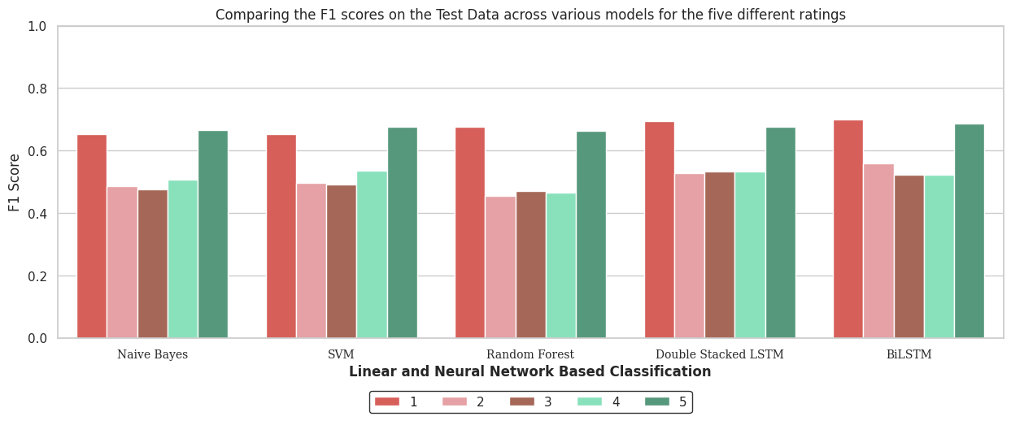
Results & Analysis: Models Comparison (100k Dataset)
Figure: F1-score Comparison Across All Models(100K Data)

Slide 35
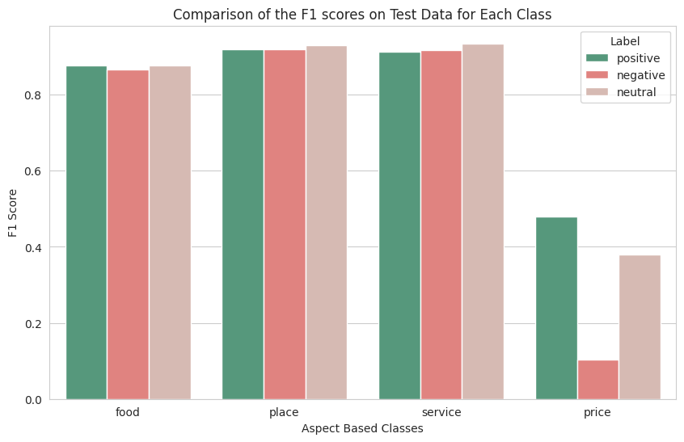
Results & Analysis: Models Comparison Based on Aspects
Figure: Comparison of the F1-scores on Test Data for Each Aspects

Slide 36
Challenges and Limitations
Future Works
High computational time for SVM model
Suboptimal F1 scores with linear models
Difficulty in classifying the "price" aspect using BiLSTM
Hyperparameter tuning for improved linear models
Explore and implement additional linear models for sentiment analysis
Enhance text features related to the "price" aspect for better classification
Experiment with neural network models like GRU and CNN for improved performance in sentiment analysis tasks

Slide 37
Conclusion
ABOM provides Deep insights into Customer opinions
Aids data-driven decisions and targeted product/service improvements
Gaining traction in multiple industries to boost customer satisfaction

Slide 38
Bibliography
D. M. Blei, A. Y. Ng, and M. I. Jordan, “Latent dirichlet allocation,” Journal of machine Learning research, vol. 3, no. Jan, pp. 993–1022, 2003.
M. Hoffman, F. Bach, and D. Blei, “Online learning for latent dirichlet allocation,” advances in neural information processing systems, vol. 23, 2010.
E. Cambria, B. Schuller, B. Liu, H. Wang, and C. Havasi, “Guest editorial special issue on concept-level opinion and sentiment analysis,” IEEE Intelligent Systems Magazine, Special Issue on Concept-Level Opinion and Sentiment Analysis, vol. 28, pp–15, 2012.
B. Liu, “Sentiment analysis and opinion mining,” Synthesis lectures on human language technologies, vol. 5, no. 1, pp. 1–167, 2012.
M. Lucas and D. Downey, “Scaling semi-supervised naive Bayes with feature marginals,” in Proceedings of the 51st Annual Meeting of the Association for Computational Linguistics (Volume 1: Long Papers), Sofia, Bulgaria: Association for Computational Linguistics, Aug. 2013, pp. 343–351. [Online]. Available: https://aclanthology.org/P13-1034.
T. Wang and G. Hirst, “Applying a naive Bayes similarity measure to word sense disambiguation,” in Proceedings of the 52nd Annual Meeting of the Association for Computational Linguistics (Volume 2: Short Papers), Baltimore, Maryland: Association for Computational Linguistics, Jun. 2014, pp. 531–537. doi: 10.3115/v1/P14-2087. [Online]. Available: https://aclanthology.org/P14-2087.
N. Hardeniya, J. Perkins, D. Chopra, N. Joshi, and I. Mathur, Natural language processing: python and NLTK. Packt Publishing Ltd, 2016.
S. Poria, E. Cambria, and A. Gelbukh, “Aspect extraction for opinion mining with a deep convolutional neural network,” Knowledge-Based Systems,vol. 108, pp. 42–49, 2016.

